Slide 1
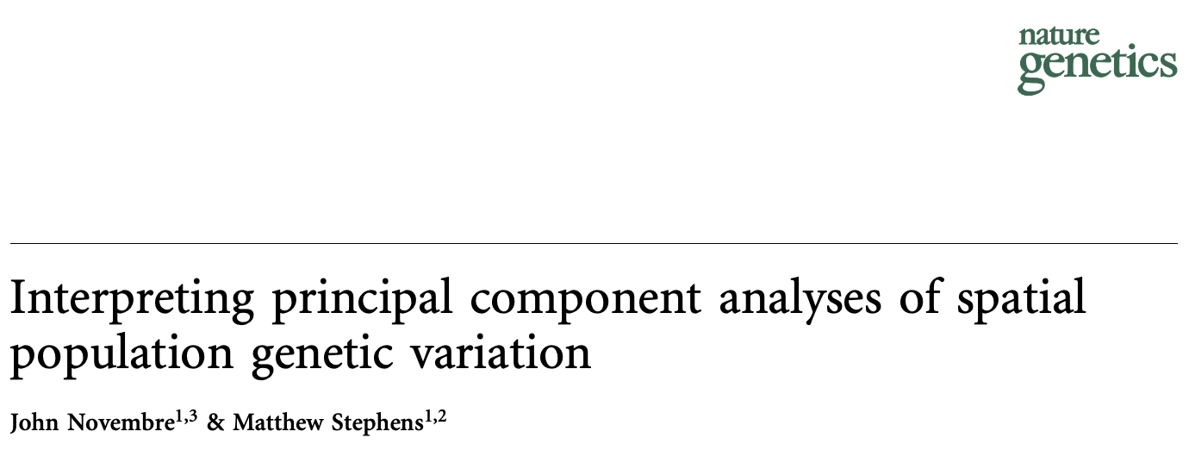

Slide 2
Intro to PCA: Motivation
Motivating question: given a bunch of high-dimensional data points, can we come up with a more efficient representation of them?
≅
x₁
x_{M}
y₁
y_{K}
x
y

Slide 3
Intro to PCA
Motivating question: given a high-dimensional dataset, how can we represent it more concisely, minimizing the amount of information lost?
≅

